Slide 1
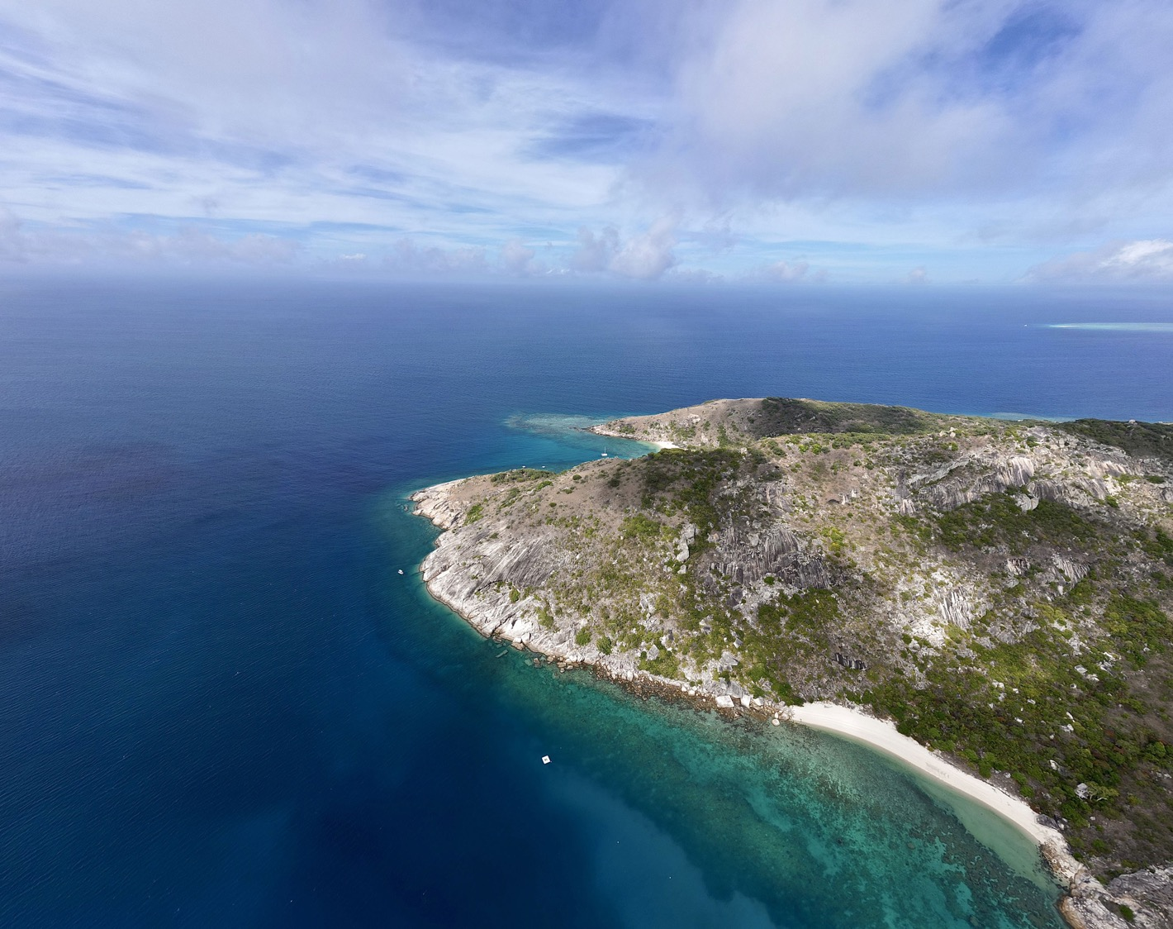
Ecological hierarchies, niches, and species Interactions
Patterns and processes in marine ecosystems
Dr George Roff
(25th July 2025)
Curtin University

Slide 2


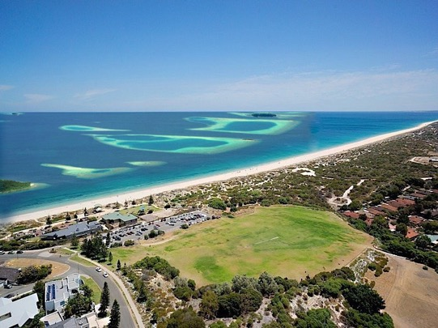
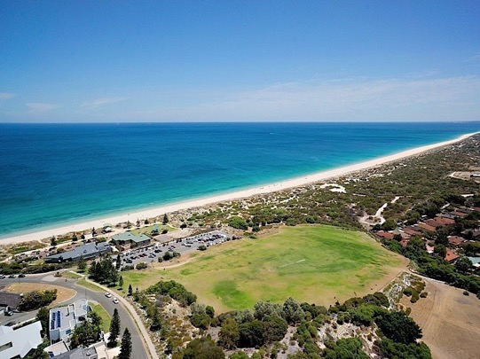
Introduction
Learning objectives:
1) Explain the concept of ecological hierarchy and define an organism’s niche.
2) Identify and describe different individual-level species interactions
3) Compare and contrast processes that shape species distribution and species abundance within ecological communities.
Pre-seminar questions:
why do some species dominate coastal habitats - but not others?
why is ecology more complex than rocket science? 🚀 🚀 🚀

Slide 3

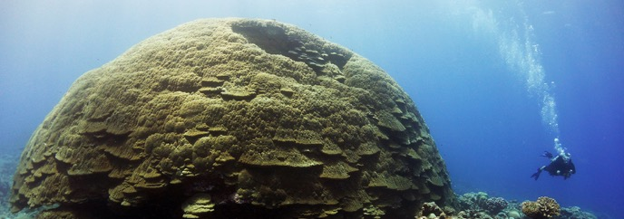
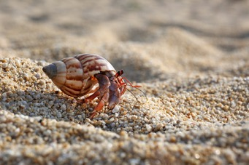
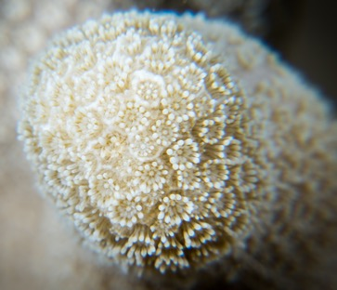
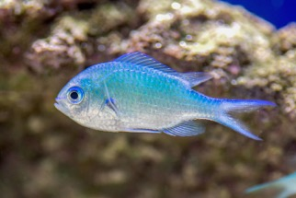
1. Ecological hierarchy - from organisms to biospheres
Ecology: “The study of organisms in their environment, including biotic and abiotic components”
Biosphere
“The global sum of all ecosystems”
Biome
“Broad ecological region, similar climate, similar organisms”
“Community interacting with each other
AND the physical environment”
Ecosystem
10m
Community
“Interacting populations of
different species in same area”
Population
“Group of individuals of the
same species in an area”
Organism
“Individual from a species”
1mm

Slide 4
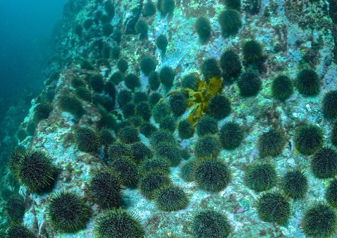
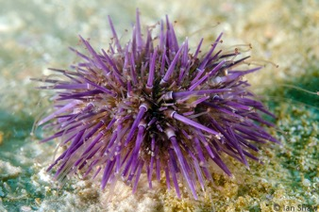
1. Ecological hierarchy - from organisms to biospheres
Ecology: “The study of organisms in their environment, including biotic and abiotic components”
Biosphere
“The global sum of all ecosystems”
Biome
“Broad ecological region, similar climate, similar organisms”
Ecosystem
“Community interacting with each other
AND the physical environment”
Community
“Interacting populations of
different species in same area”
Population
“Group of individuals of the
same species in an area”
Organism
“Individual from a species”

Slide 5
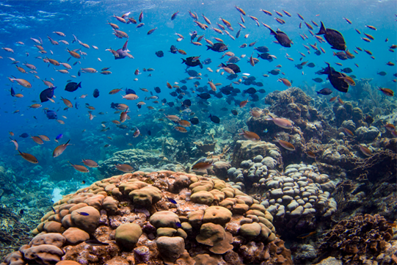
1. Ecological hierarchy - from organisms to biospheres
Ecology: “The study of organisms in their environment, including biotic and abiotic components”
Biosphere
“The global sum of all ecosystems”
Biome
“Broad ecological region, similar climate, similar organisms”
Ecosystem
“Community interacting with each other
AND the physical environment”
Community
“Interacting populations of
different species in same area”
Population
“Group of individuals of the
same species in an area”
Organism
“Individual from a species”
Notes:
A community is the assemblage of different populations of species: 1) diversity, 2) interactions between species, 3) trophic structure, 4) temporal dynamics

Slide 6
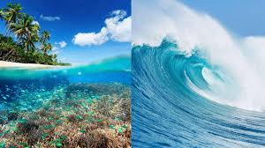
1. Ecological hierarchy - from organisms to biospheres
Ecology: “The study of organisms in their environment, including biotic and abiotic components”
Biosphere
“The global sum of all ecosystems”
Biome
“Broad ecological region, similar climate, similar organisms”
Ecosystem
“Community interacting with each other
AND the physical environment”
Community
“Interacting populations of
different species in same area”
Population
“Group of individuals of the
same species in an area”
Organism
“Individual from a species”
Notes:
interactions involve energy flow (e.g. through food webs) and nutrient cycling (movement and transformation of essential elements)

Slide 7
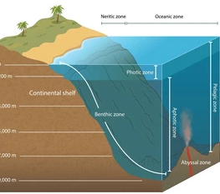
1. Ecological hierarchy - from organisms to biospheres
Ecology: “The study of organisms in their environment, including biotic and abiotic components”
Biosphere
“The global sum of all ecosystems”
Biome
“Broad ecological region, similar climate, similar organisms”
Ecosystem
“Community interacting with each other
AND the physical environment”
Community
“Interacting populations of
different species in same area”
Population
“Group of individuals of the
same species in an area”
Organism
“Individual from a species”
Notes:
For example: coral reefs, pelagic (open ocean), polar seas,
First defined in the early 1900’s as vegetation types, later expanded to include plants and animals,
Terrestrial: “climatically defined”, less clear in marine systems

Slide 8
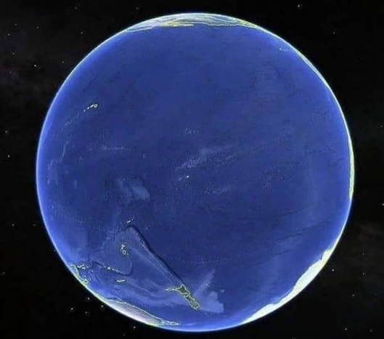
1. Ecological hierarchy - from organisms to biospheres
Ecology: “The study of organisms in their environment, including biotic and abiotic components”
Biosphere
“The global sum of all ecosystems”
Biome
“Broad ecological region, similar climate, similar organisms”
Ecosystem
“Community interacting with each other
AND the physical environment”
Community
“Interacting populations of
different species in same area”
Population
“Group of individuals of the
same species in an area”
Organism
“Individual from a species”
Notes:
global sum of all ecosystems, including all zones of the atmosphere, hydrosphere, and lithosphere where life exists.

Slide 9
1. Ecological hierarchy - scaling in ecology
Biotic scale
Spatial scale
Biosphere
expands with each level
individual microhabitats to global systems
Biome
Temporal scale
Ecosystem
increases with complexity
fast physiological changes to evolutionary and planetary processes.
Community
Population
Ecological phenomena are multi-scalar:
Organism
Larval dispersal links individuals, populations, and regional metacommunities.
Climate change acts globally but impacts species and ecosystems locally.
Notes:
Spatial scale expands with each level, from individual microhabitats to global systems.
Temporal scale increases with complexity, from fast physiological changes to evolutionary and planetary processes.

Slide 10
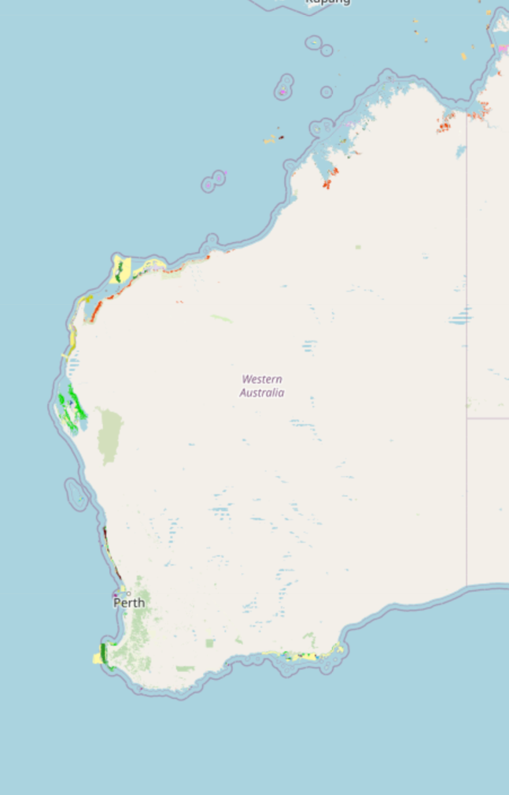
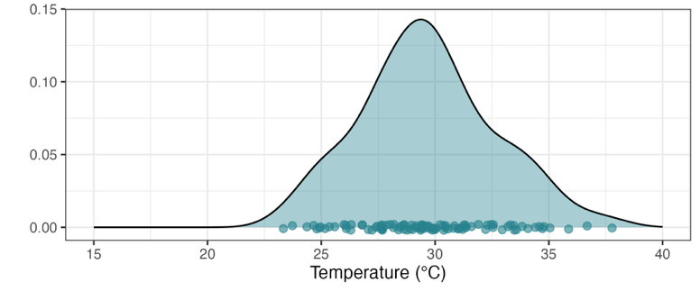
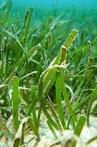
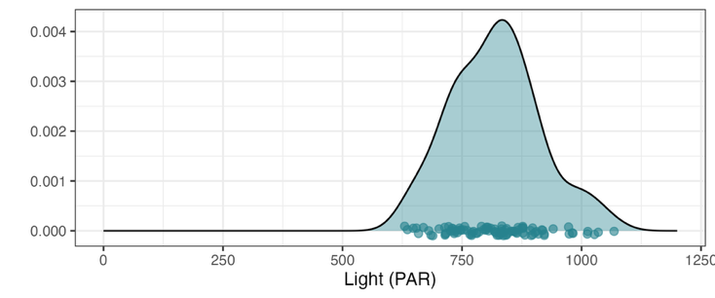
2. Species niches - where do species live… and why?
Environmental niche: “set of environmental conditions under which the species
can survive, grow, and reproduce”
Example: tropical seagrass surveys(Cymodocea)
Temperature
2. tropical preference
1. absent in
cold water
3. thermally tolerant
cool
warm
Light
4. mid-high light optima
5. broad light range
low
high

Slide 11
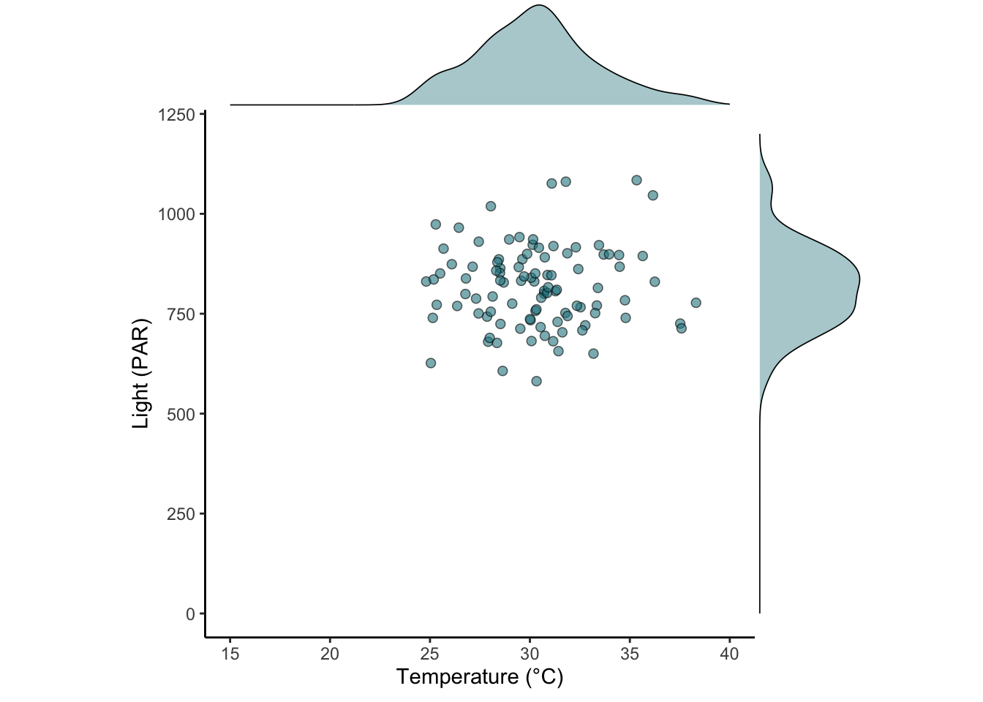
2. Species niches – environmental drivers
Example: WA seagrass surveys - Cymodocea
Temperature
cool
warm
high
Light
Cymodocea
low
Notes:
A 2-dimensional niche space visualizes a species’ tolerance and performance along two environmental axes

Slide 12
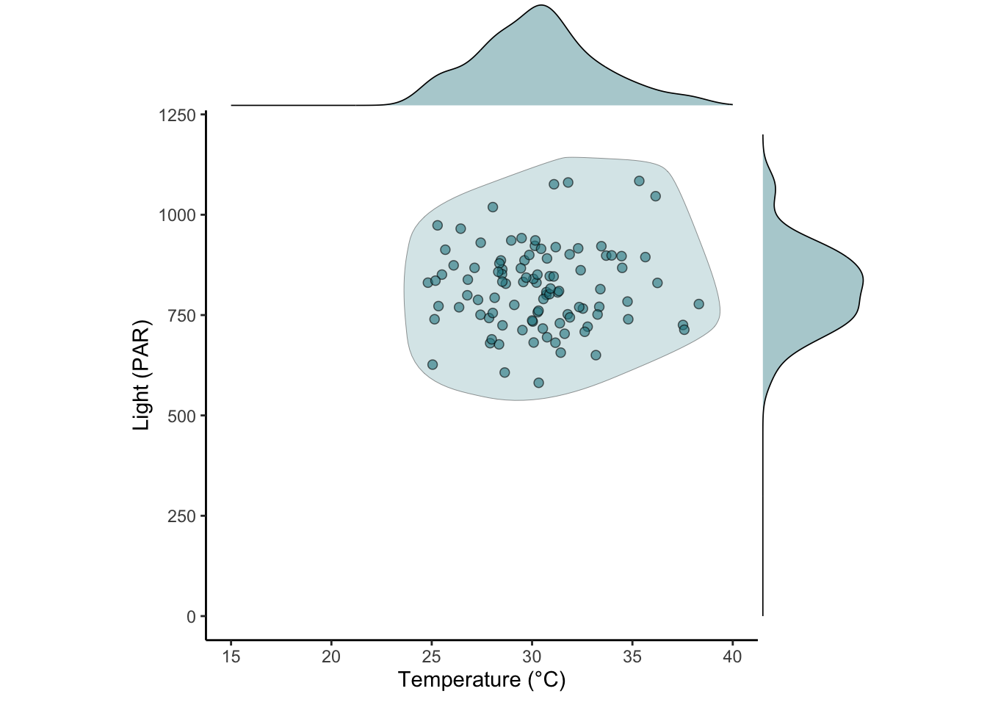
2. Species niches – environmental drivers
Example: WA seagrass surveys - Cymodocea
Temperature
cool
warm
high
Light
Cymodocea
3. mid-high light optima
2. temperature tolerant
1. absent in
cold water
low

Slide 13
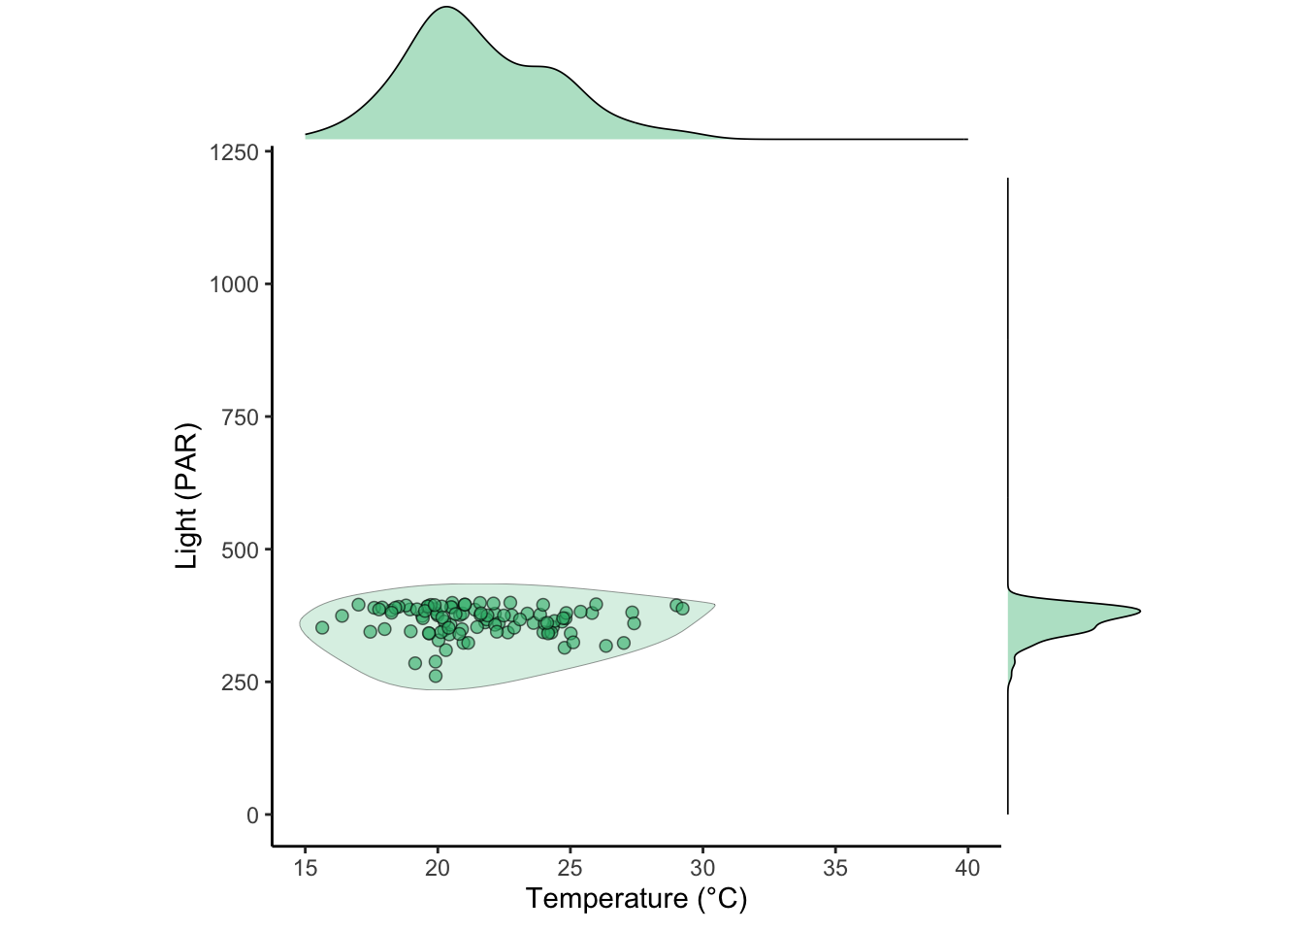
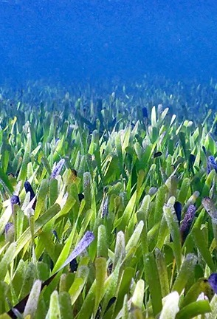
2. Species niches – environmental drivers
Example: WA seagrass surveys - Posidonia
Posidonia
1. absent in
warmer water
Cymodocea
2. temperature tolerant
3. Narrow light range

Slide 14
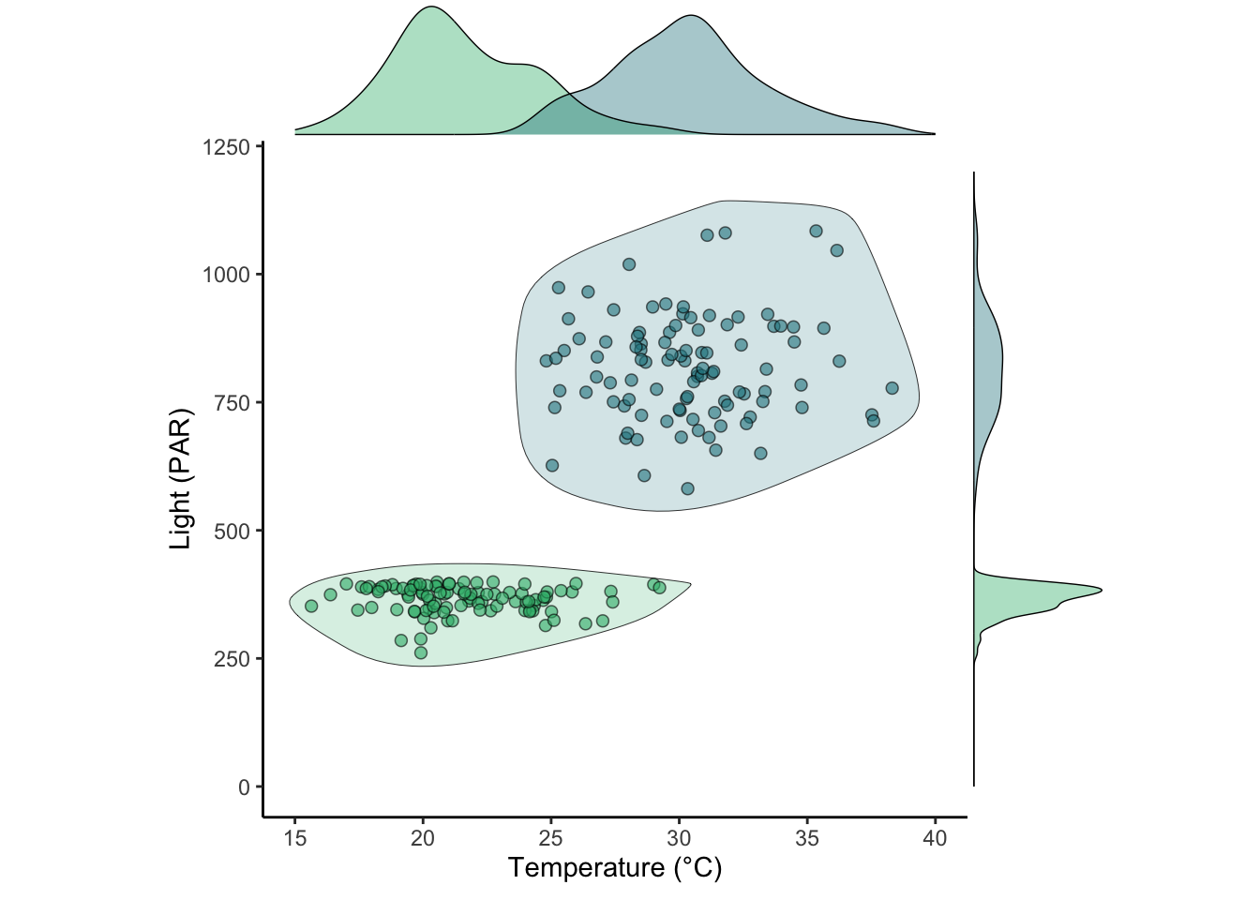
2. Species niches – environmental drivers and species distributions
Niche overlap
Potential for coexistence?
Posidonia
Cymodocea
Posidonia
Cymodocea
Cymodocea
Distinct niche
spaces
Posidonia
Unlikely
cooccurrence

Slide 15
2. Species niches – environmental drivers and species distributions
Posidonia
Cymodocea
Posidonia
Cymodocea
Cymodocea
Posidonia

Slide 16
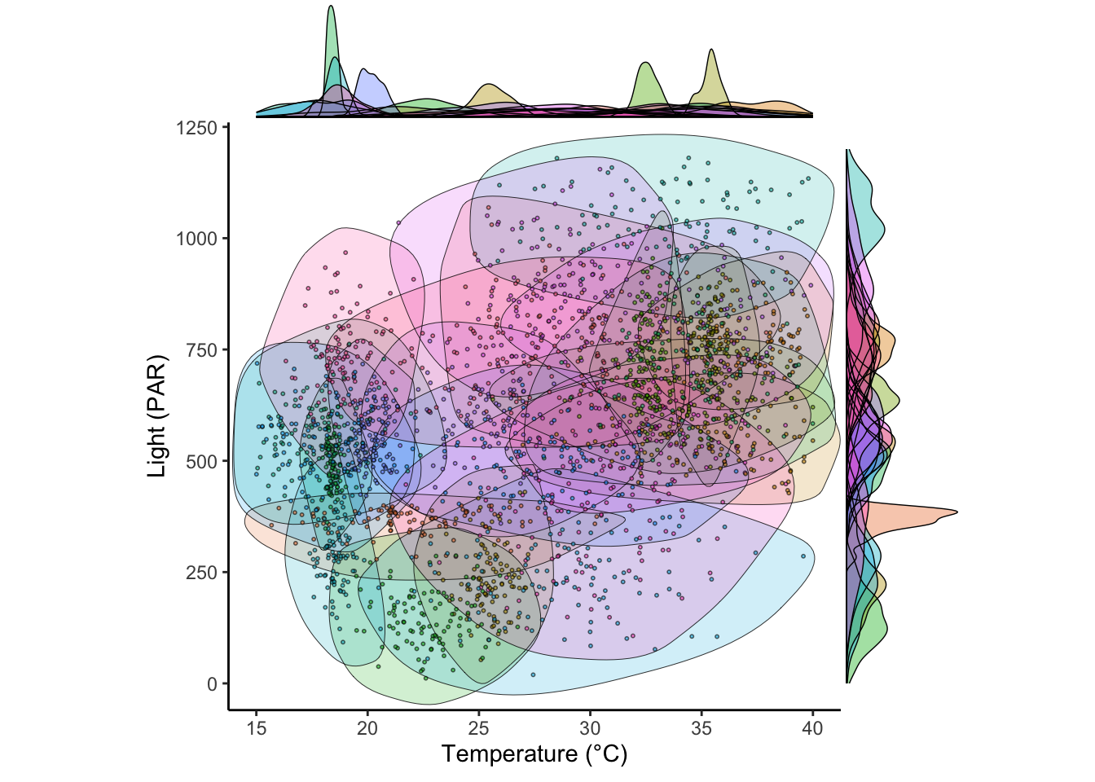
2. Species niches – environmental drivers
Western Australia: 26 seagrass species, ~30,000km coastline
… it’s complicated
Posidonia
Cymodocea

Slide 17
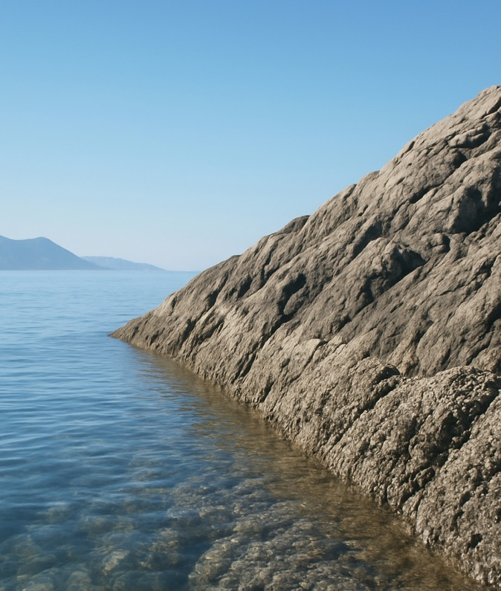
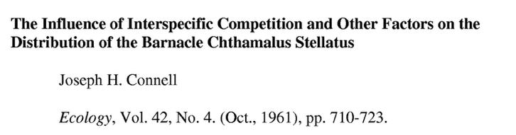
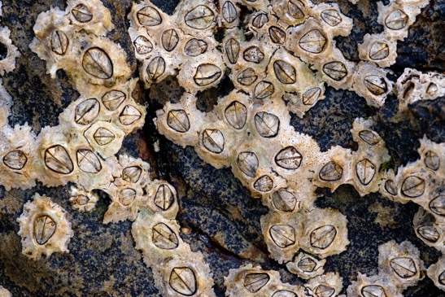
2. Species niches – biotic interactions
Barnacles and rocky intertidal shores (Scotland)
High tide
Chthamalus
Chthamalus
fundamental
niche
Balanus
Low tide

Slide 18
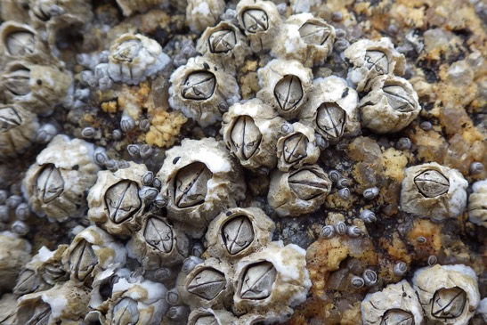
2. Species niches – biotic interactions
Barnacles and rocky intertidal shores (Scotland)
High tide
desiccation
Balanus
fundamental
niche
Balanus
Low tide

Slide 19
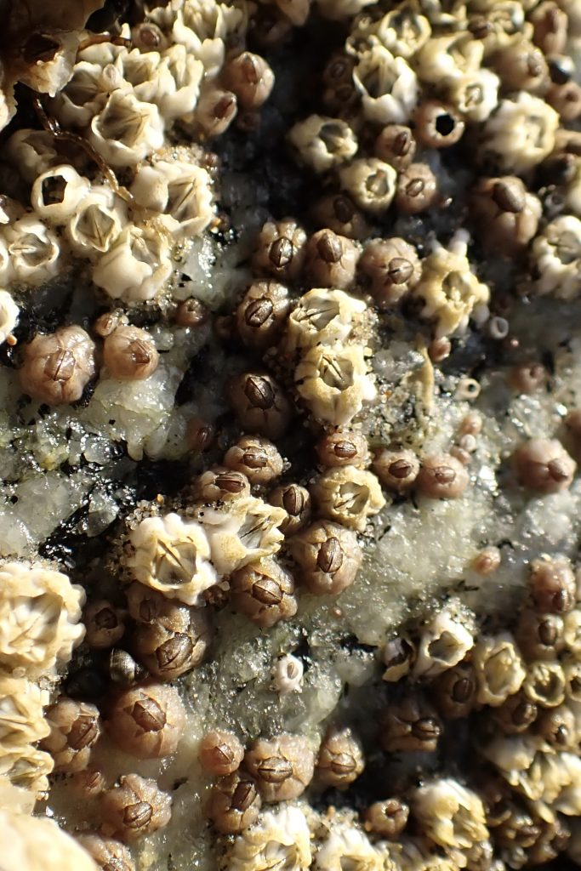
2. Species niches – biotic interactions regulate niche availability
Barnacles and rocky intertidal shores (Scotland)
High tide
Chthamalus
fundamental
niche
Chthamalus
realised niche
Balanus
fundamental
niche
Low tide
fundamental niche: where it could live? (abiotic)
realised niche: where it does live? (abiotic & biotic)

Slide 20
3. Individual-level interactions – what are the outcomes when two species interact?
Organisms at the base of the pyramid
Ecological hierarchy
Biosphere
Organism
Species B
Species A
vs
=. ……?
Notes:
At the base of the pyramid, interactions drive the hierarchy.

Slide 21

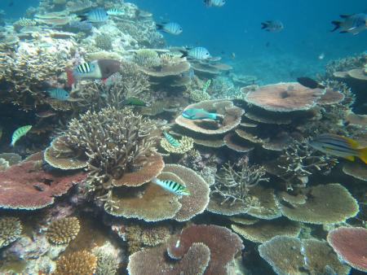
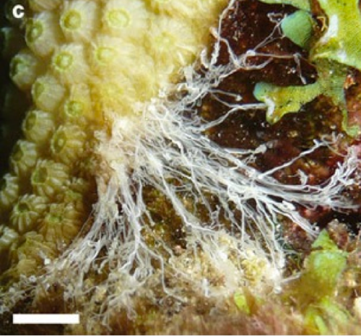
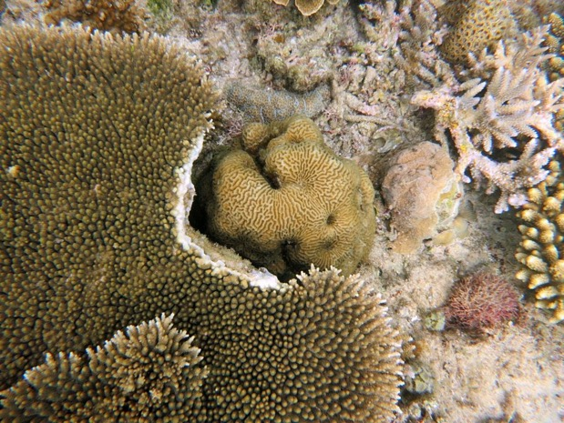
3. Individual-level interactions
Type | Species A | Species B | Example
Competition | – | – | Scleractinian corals
Can be asymmetric
Notes:
Can be….assymetric

Slide 22

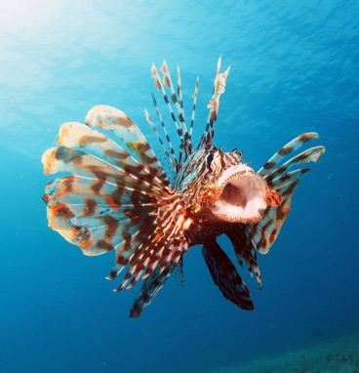
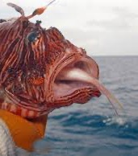
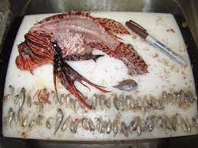
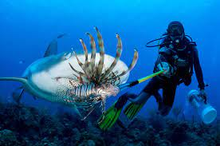
3. Individual-level interactions
Type | Species A | Species B | Example
Competition | – | – | Scleractinian corals
Predation | + | – | Lionfish

Slide 23
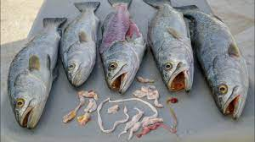
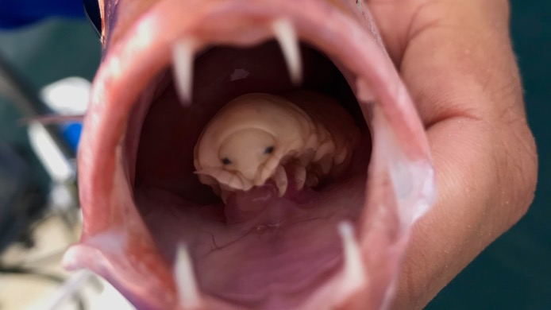
3. Individual-level interactions
Type | Species A | Species B | Example
Competition | – | – | Scleractinian corals
Predation | + | – | Lionfish
Parasitism | + | – | Marine worms, isopods
Notes:
One organism benefits at the expense of another

Slide 24
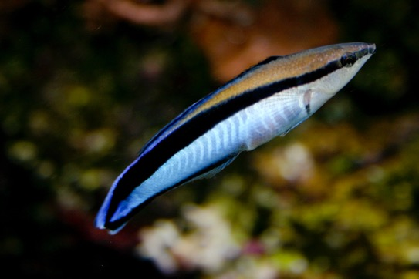
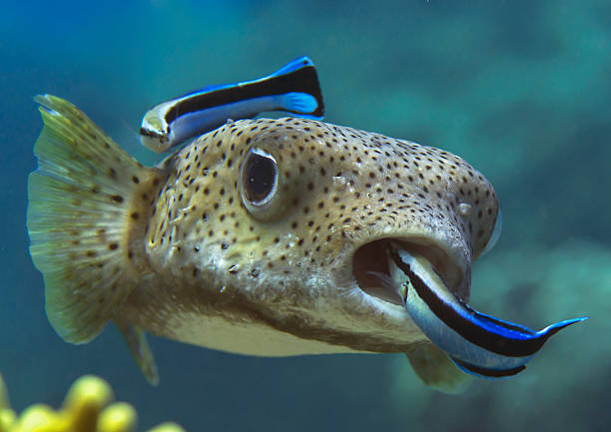
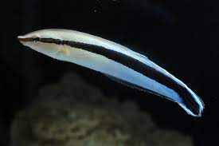
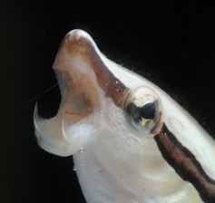
3. Individual-level interactions
Type | Species A | Species B | Example
Competition | – | – | Scleractinian corals
Predation | + | – | Lionfish
Parasitism | + | – | Marine worms, isopods
Mutualism | + | + | Cleaner wrasse

Slide 25
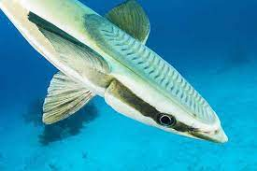
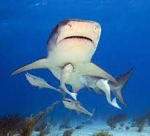
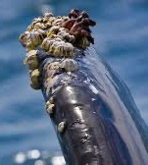
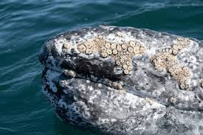
3. Individual-level interactions
Type | Species A | Species B | Example
Competition | – | – | Scleractinian corals
Predation | + | – | Lionfish
Parasitism | + | – | Marine worms, isopods
Mutualism | + | + | Cleaner wrasse
Commensalism | + | 0 | Remora fish, barnacles
Notes:
One organism benefits while the other is unaffected

Slide 26
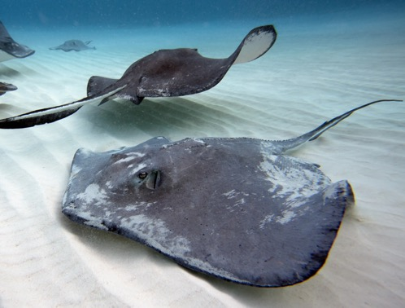
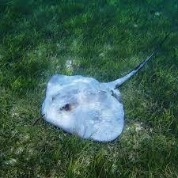
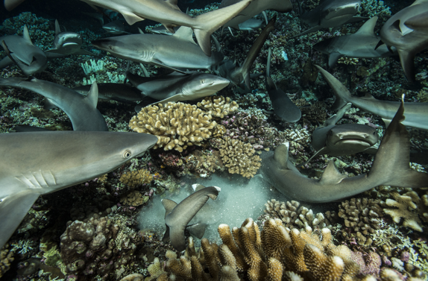
3. Individual-level interactions
Type | Species A | Species B | Example
Competition | – | – | Scleractinian corals
Predation | + | – | Lionfish
Parasitism | + | – | Marine worms, isopods
Mutualism | + | + | Cleaner wrasse
Commensalism | + | 0 | Remora fish, barnacles
Amensalism | – | 0 | Stingray bioturbation
Notes:
One organism is harmed while the other is unaffected

Slide 27
4. Distribution and abundance - what are the combined factors affecting where species live?
Example
Scale
Abiotic factors
Broad-scale
Temperature, salinity, turbidity
Biotic factors
Local-scale
Predation, competition, mutualism
Notes:
Abiotic (climate, substrate)
Biotic (predators, competitors)
Dispersal (barriers, vectors)
Disturbance (fire, cyclone)
Historical (land use, evolution)

Slide 28
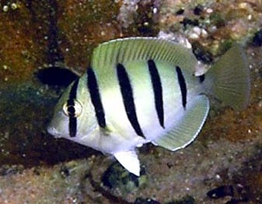
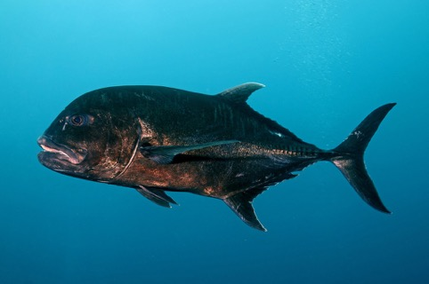

4. Distribution and abundance
Example
Scale
Abiotic factors
Broad-scale
Temperature, salinity, turbidity
Biotic factors
Local-scale
Predation, competition, mutualism
Dispersal
Regional
Ocean currents, larval biology
Pelagic larval duration
Geographic isolation
~5-8 days
~70-80 days
Notes:
Abiotic (climate, substrate)
Biotic (predators, competitors)
Dispersal (barriers, vectors)
Disturbance (fire, cyclone)
Historical (land use, evolution)

Slide 29


4. Distribution and abundance
Example
Scale
Abiotic factors
Broad-scale
Temperature, salinity, turbidity
Biotic factors
Local-scale
Predation, competition, mutualism
Dispersal
Regional
Ocean currents, larval duration
Disturbance
Episodic, local-regional
Marine heatwaves, storms, floods
Notes:
displace species, open space for colonization, reset successional stages, and create patchy distributions by favouring tolerant or opportunistic species

Slide 30

4. Distribution and abundance
Example
Scale
Abiotic factors
Broad-scale
Temperature, salinity, turbidity
Biotic factors
Local-scale
Predation, competition, mutualism
Eastern-Pacific
Barrier
Amazon
barrier
Dispersal
Regional
Ocean currents, larval duration
Disturbance
Episodic, local-regional
Marine heatwaves, storms, floods
Legacy effects
Dispersal barriers, dredging, hypoxia
Long-term / deep time

Slide 31
5. Summary and topic review
Ecology is structured in hierarchical levels
Niches define the ecological ‘role’ of species
Individual interactions can scale up to shape communities
Distribution and abundance of species arise from multiple interacting processes
Quick Review…
What limits a species’ realized niche?
Give an example of mutualism.
How do disturbance and dispersal shape community composition?
why is ecology more complex than rocket science? 🚀 🚀 🚀
Notes:
Ecology operates in hierarchies
Niches are constrained by interactions
Community patterns are process-driven
QUESTIONS: classify these interactions.
Competition (intra-/inter-specific) - Predation/herbivory - Parasitism - Mutualism - Commensalism - Amensalism

Slide 32


Ecology vs rocket science 🚀
Rocket science: the study and application of the physics and engineering required to design, build, and launch rockets
Ecology: The study of organisms in their environment
n-dimensional hypervolume (biotic factors, 1:n)
Abiotic drivers
Species interactions
Scale-dependence
Emergent properties
Stochasticity….
Complexity lies in deterministic physics and precision
Dynamic systems (n-dimensions) that are inherently difficult to quantify!
Notes:
p = linear momentum
L = angular momentum
m = mass
k = gravitational force.
Ecology: Dynamic systems with many interacting species and abiotic factors (also stochasticity, scale-dependence, emergent properties, ecological surprise…)

Slide 33
5. Follow-up work
Simulated species niches:
How does visualizing an organism’s niche as a 3D volume help us understand its ecological requirements and potential for coexistence with other species?
2. What do the axes in a 3D niche space typically represent, and how would changing environmental conditions shift a species’ position or volume within this space?
3. How can overlapping 3D niches between species indicate potential competition, and what factors might allow them to coexist despite this overlap?

